Slide 1
MALIGNANT COMMENT PROJECT
BY – KHUSHBOO GUPTA

Slide 2
Problem Statement
The proliferation of social media enables people to express their opinions widely online. However, at the same time, this has resulted in the emergence of conflict and hate, making online environments uninviting for users. Although researchers have found that hate is a problem across multiple platforms, there is a lack of models for online hate detection. Online hate, described as abusive language, aggression, cyberbullying, hatefulness and many others has been identified as a major threat on online social media platforms. Social media platforms are the most prominent grounds for such toxic behaviour. There has been a remarkable increase in the cases of cyberbullying and trolls on various social media platforms. Many celebrities and influences are facing backlashes from people and have to come across hateful and offensive comments. This can take a toll on anyone and affect them mentally leading to depression, mental illness, self-hatred and suicidal thoughts. Internet comments are bastions of hatred and vitriol. While online anonymity has provided a new outlet for aggression and hate speech, machine learning can be used to fight it. The problem we sought to solve was the tagging of internet comments that are aggressive towards other users. This means that insults to third parties such as celebrities will be tagged as unoffensive, but “u are an idiot” is clearly offensive. Our goal is to build a prototype of online hate and abuse comment classifier which can used to classify hate and offensive comments so that it can be controlled and restricted from spreading hatred and cyberbullying.

Slide 3
Our Exercise
Build a model which can be used to predict in terms of a probability for each comment, whether it falls in the category of bad comment or not. In this case, Label ‘1’ indicates that the comment is bad, while, Label ‘0’ indicates that it doesn’t falls in bad category.

Slide 4
Data description
The data set contains the training set, which has approximately 1,59,000 samples and the test set which contains nearly 1,53,000 samples. All the data samples contain 8 fields which includes ‘Id’, ‘Comments’, ‘Malignant’, ‘Highly malignant’, ‘Rude’, ‘Threat’, ‘Abuse’ and ‘Loathe’. The label can be either 0 or 1, where 0 denotes a NO while 1 denotes a YES. There are various comments which have multiple labels. The first attribute is a unique ID associated with each comment. The data set includes:
Malignant: It is the Label column, which includes values 0 and 1, denoting if the comment is malignant or not.
Highly Malignant: It denotes comments that are highly malignant and hurtful.
Rude: It denotes comments that are very rude and offensive.
Threat: It contains indication of the comments that are giving any threat to someone.
Abuse: It is for comments that are abusive in nature.
Loathe: It describes the comments which are hateful and loathing in nature.
ID: It includes unique Ids associated with each comment text given.
Comment text: This column contains the comments extracted from various social media platforms.

Slide 5
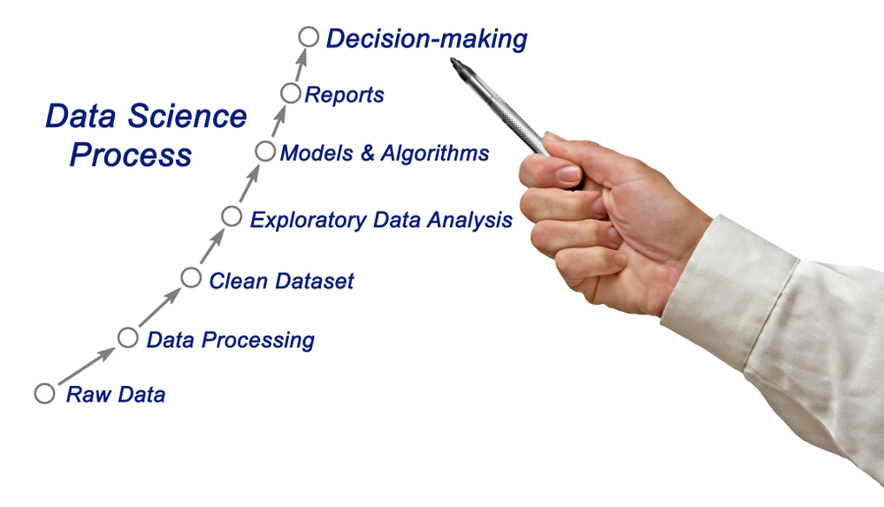

Slide 6
Steps Involved
Load the dataset
Distinguish the attributes
Checking the null values & handled them accordingly
Do the EDA
Check the correlation & removing the outliers
Feature Engineering – Find the best machine learning model to get the best accuracy.
Check the cross val score & perform the hypermeter tuning.
Save the model & check the predicted & actual values using the best saved model.

Slide 7
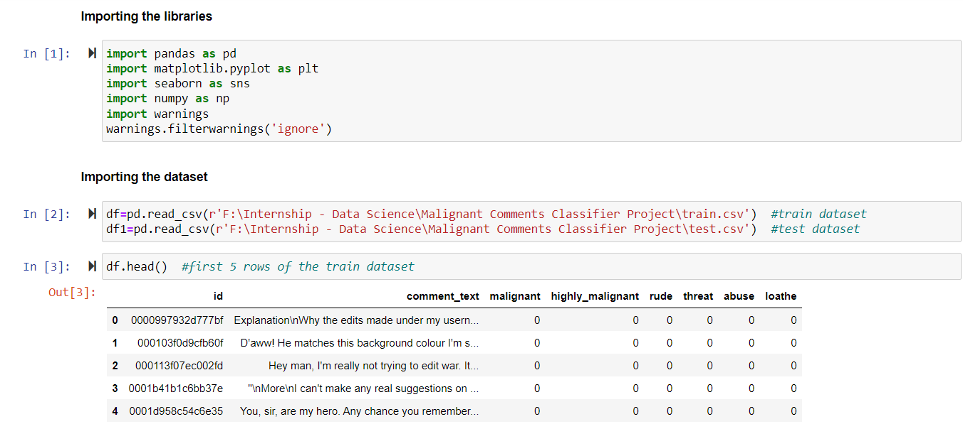
Load the dataset

Slide 8
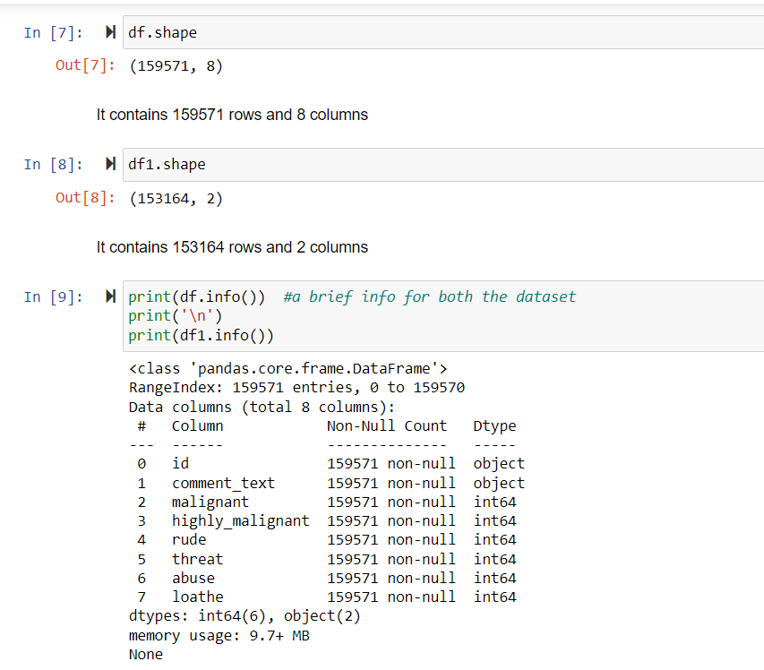
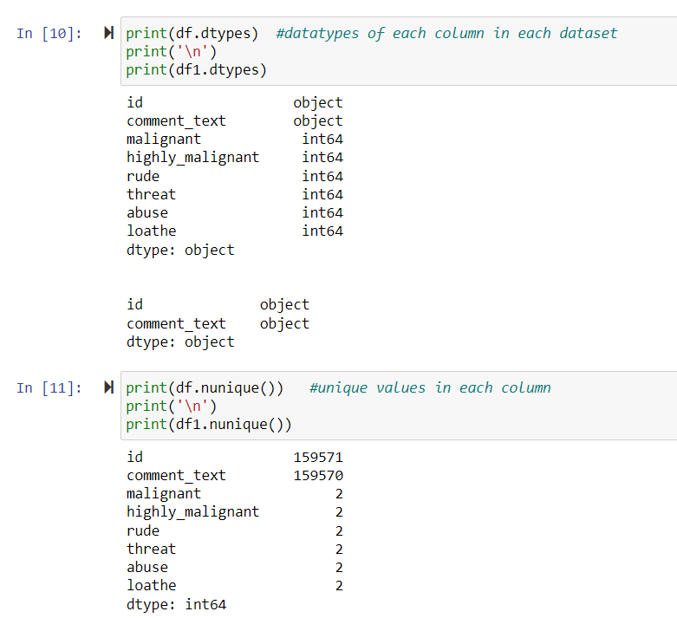
Checking the Attributes
First & last five rows the dataset
Shape of the dataset
Columns present in the dataset
Brief info about the dataset
Datatype of each column
Null values present in the dataset
Number of unique values present in each column

Slide 9
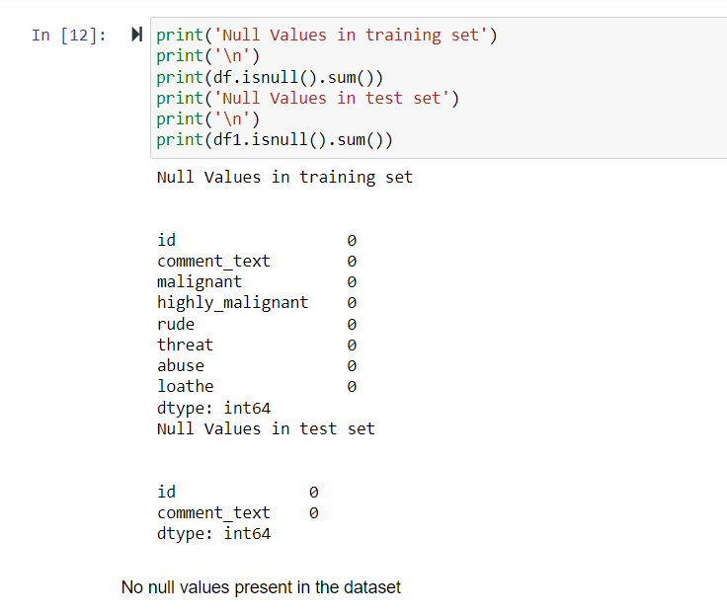
Null Values
As both the dataset doesn’t contain the null values so there is no need of null values handling and we can proceed further.

Slide 10
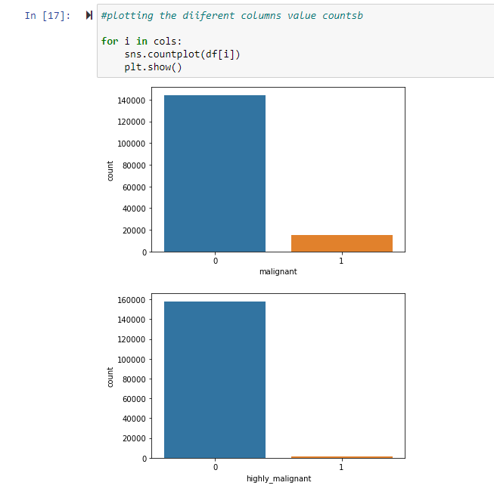
EDA
By using the different plots we try to visualize the each column with the target column.

Slide 11
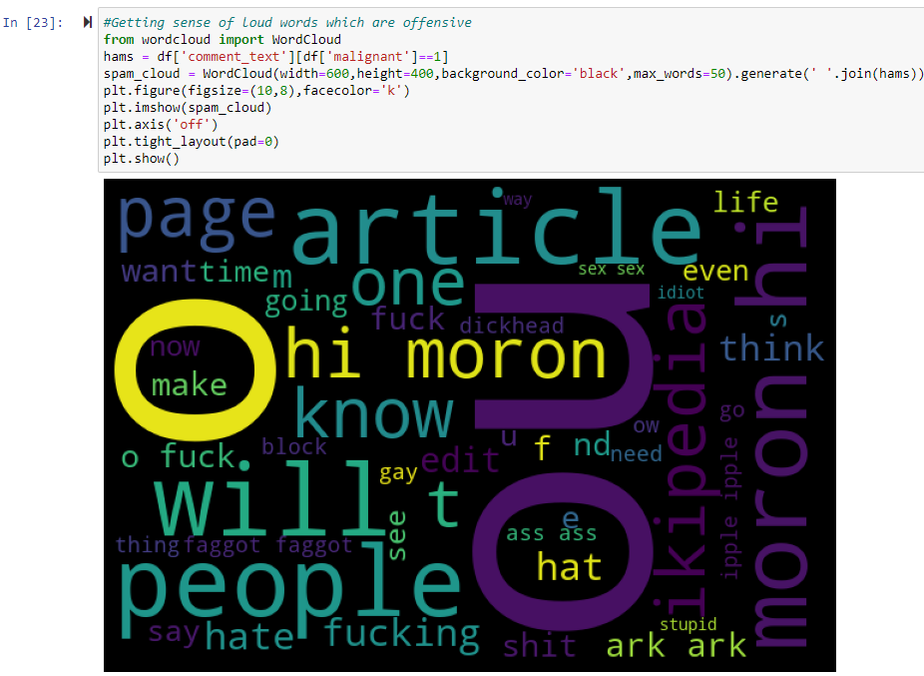
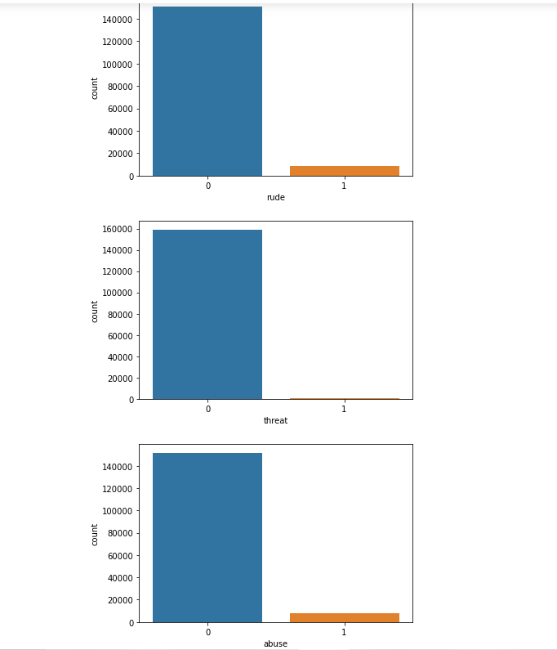
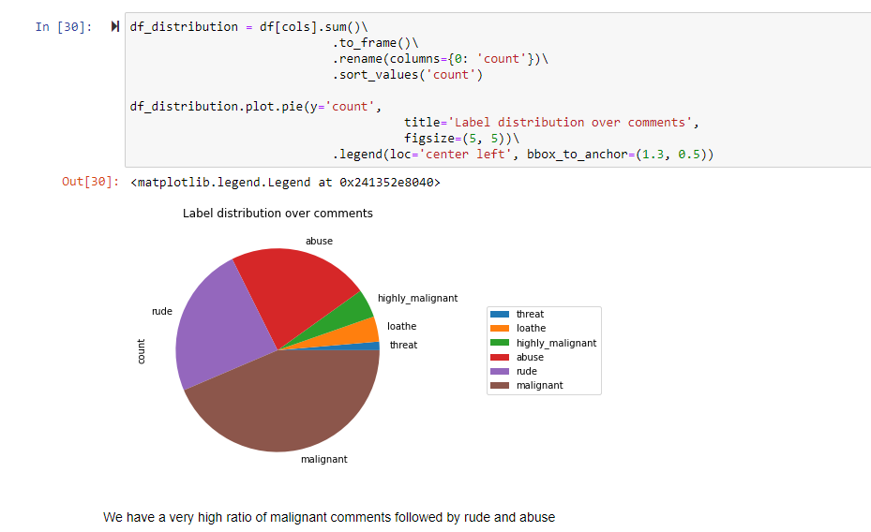

Slide 12
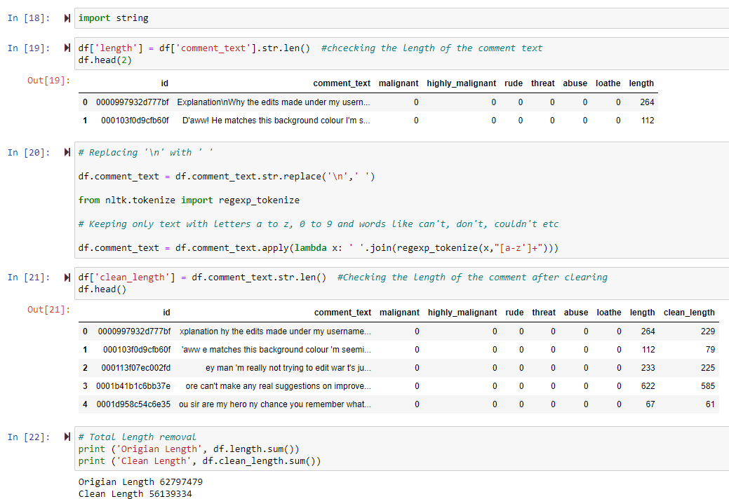
After Doing the EDA, let’s do the next step
Cleaning the comment_text column as it contains other characters as well, so we need to remove this
Afterwards, using the describe function we will elaborate the statistical summary of the dataset which contains the count, min, max, standard deviation, mean etc. of every column.
Find the correlation between each column
Plotting the outliers using boxplot
Checking the skewness.

Slide 13
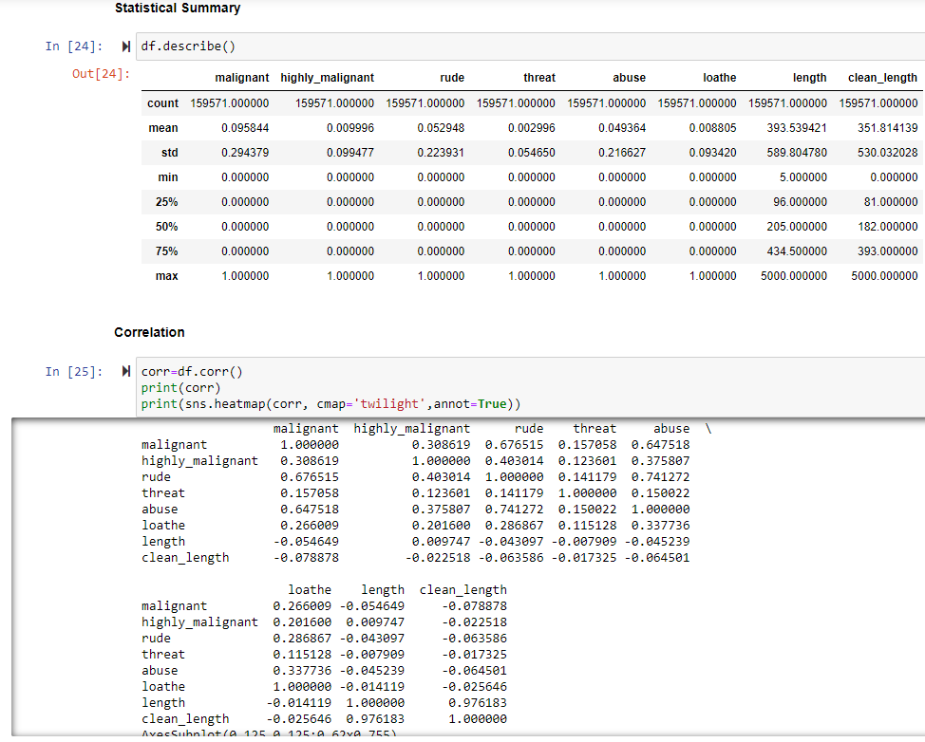
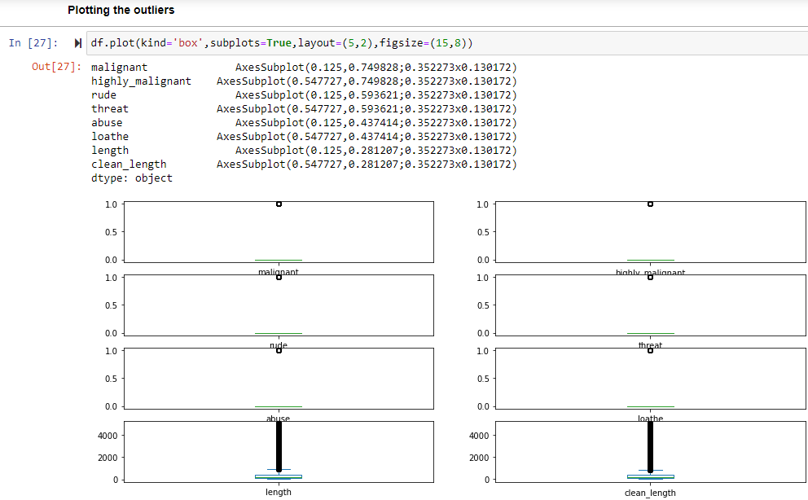
STATISTICAL SUMMARY, CORRELATION, OUTLIERS

Slide 14


Slide 15
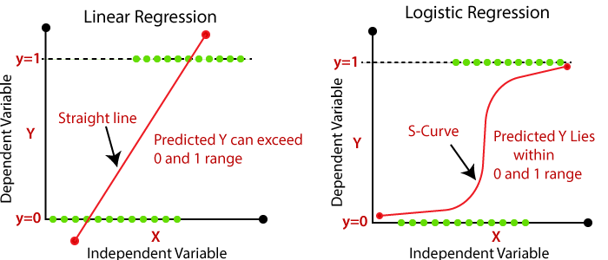
Is this a Regression problem or Classification problem?
By looking at the output i.e. target variables, this is a binary output either 1 or 0 not a continuous output so we go for the classification machine learning algorithms to predict the defaulter.
What does Classification mean?
Classification is the process of finding or discovering a model or function which helps in separating the data into multiple categorical classes i.e. discrete values. In classification, data is categorized under different labels according to some parameters given in input and then the labels are predicted for the data.

Slide 16
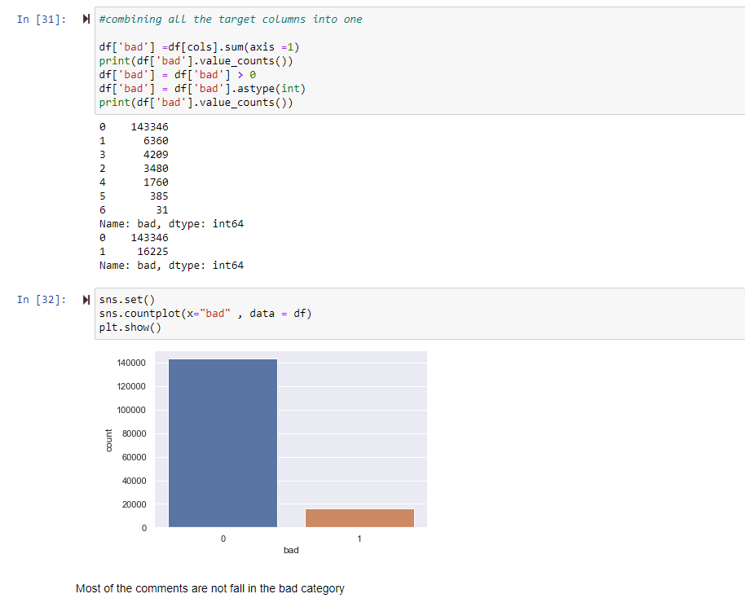
Target variable
As we see, we have more than one target column in our dataset i.e. malignant, highly_malignant, rude, threat, abuse, loathe. So, we will create a separate which will contain the sum of different row entries. If the sum of all the target variable is 1 or more than 1, then it is malignant otherwise if sum is zero, then it is not malignant.

Slide 17
Used Classification Algorithms
Logistic Regression
from sklearn.linear_model import LogisticRegression
Decision Tree Classifier
from sklearn.tree import DecisionTreeClassifier
KNN Classifier
from sklearn.neighbors import KNeighborsClassifier
Random Forest Classifier
from sklearn.ensemble import RandomForestClassifier
Multinomial NB
from sklearn.naive_bayes import MultinomialNB
AdaBoost Classifier
from sklearn.ensemble import AdaBoostClassifier
GradientBoosting Classifier
from sklearn.ensemble import GradientBoostingClassifier
MODEL | ACCURACY
Logistic Regression | 0.9485503008021391
Decision Tree Classifier | 0.9198696524064172
Random Forest Classifier | 0.9454169451871658
KNN Classifier | 0.5836397058823529
Multinomial NB | 0.9416986965240641
Adaboost Classifier | 0.93829378342246
GradientBoost Classifer | 0.934136864973262

Slide 18
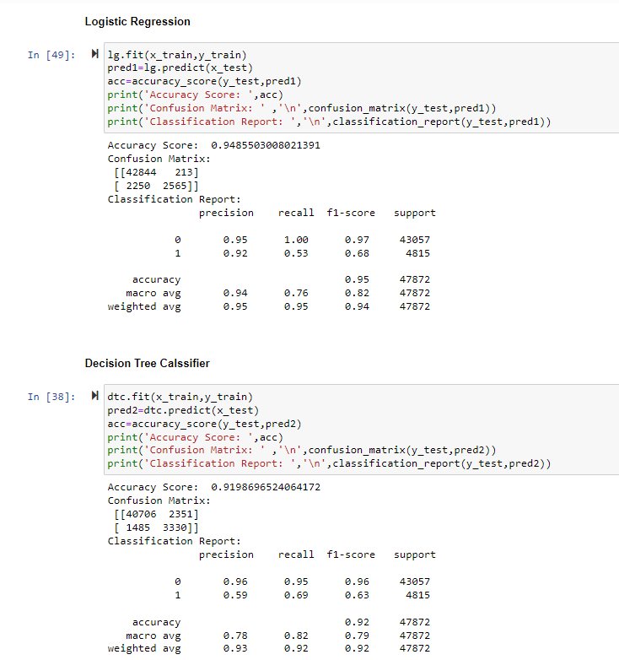
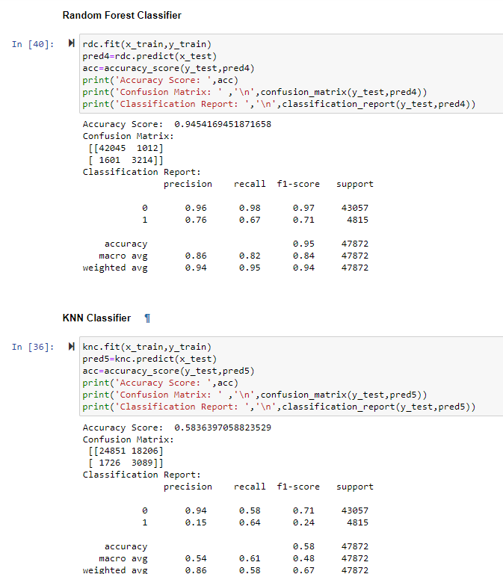
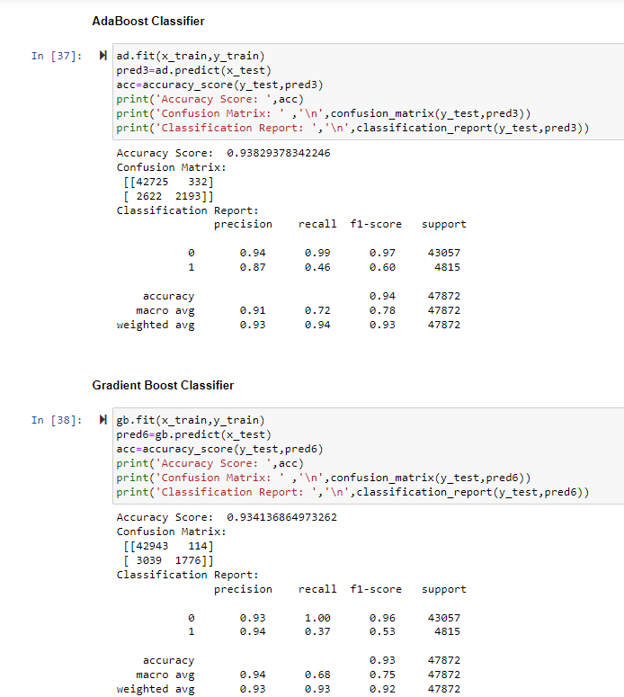

Slide 19
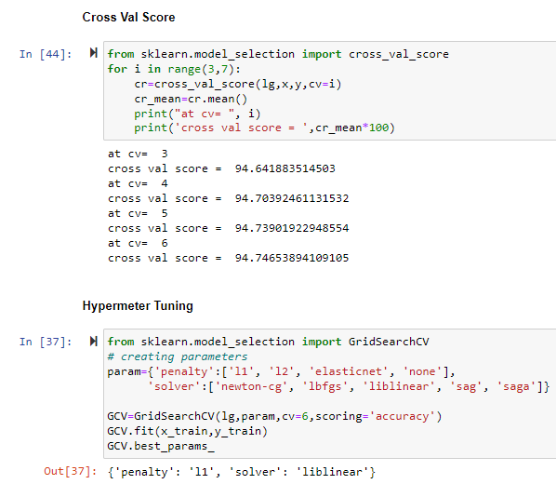
Cross Val Score & Hypermeter Tuning
Finding the cv at which the model runs the best.
Finding the parameters of the model whose accuracy we found the best at which it runs the best using the hypermeter tuning.

Slide 20
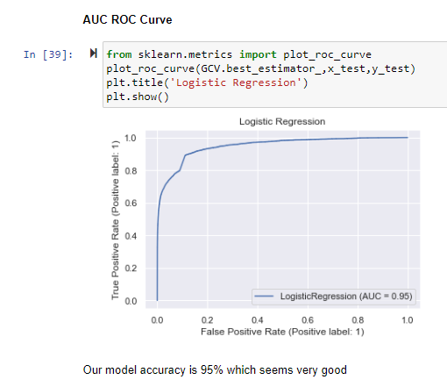
AUC-ROC Curve
What is AUC-ROC Curve?
The Receiver Operator Characteristic (ROC) curve is an evaluation metric for binary classification problems. It is a probability curve that plots the TPR against FPR at various threshold values and essentially separates the ‘signal’ from the ‘noise’. The Area Under the Curve (AUC) is the measure of the ability of a classifier to distinguish between classes and is used as a summary of the ROC curve.
The higher the AUC, the better the performance of the model at distinguishing between the positive and negative classes.
In our model AUC>0.5, so there is a high chance that the classifier will be able to distinguish the positive class values from the negative class values.

Slide 21
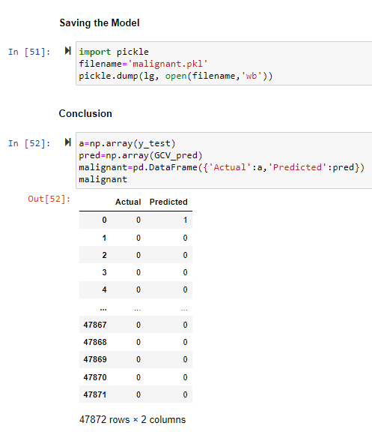
Saving the Model
After doing all the EDA process and find our best regression algorithm we will save that model for future predictions using the pickle algorithm.
We will conclude after comparing the actual & predicted values.

Slide 22
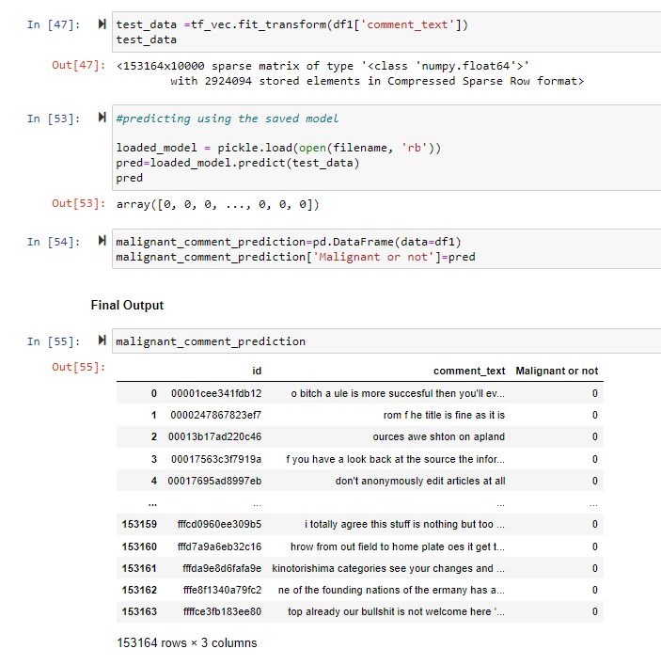
Predicting for the test dataset
We save our model with 95% accuracy and now we can use it to predict whether the comment falls in the category of a malignant comment or not. If it comes to ‘0’ that means it is not a malignant comment and if it is ‘1’ then it is a malignant comment. But before that we have to clean the comment_text as we did in training part and convert it into vector for proper prediction.

Slide 23


